Slide 1
Spring Boot Batch Processing

Slide 2
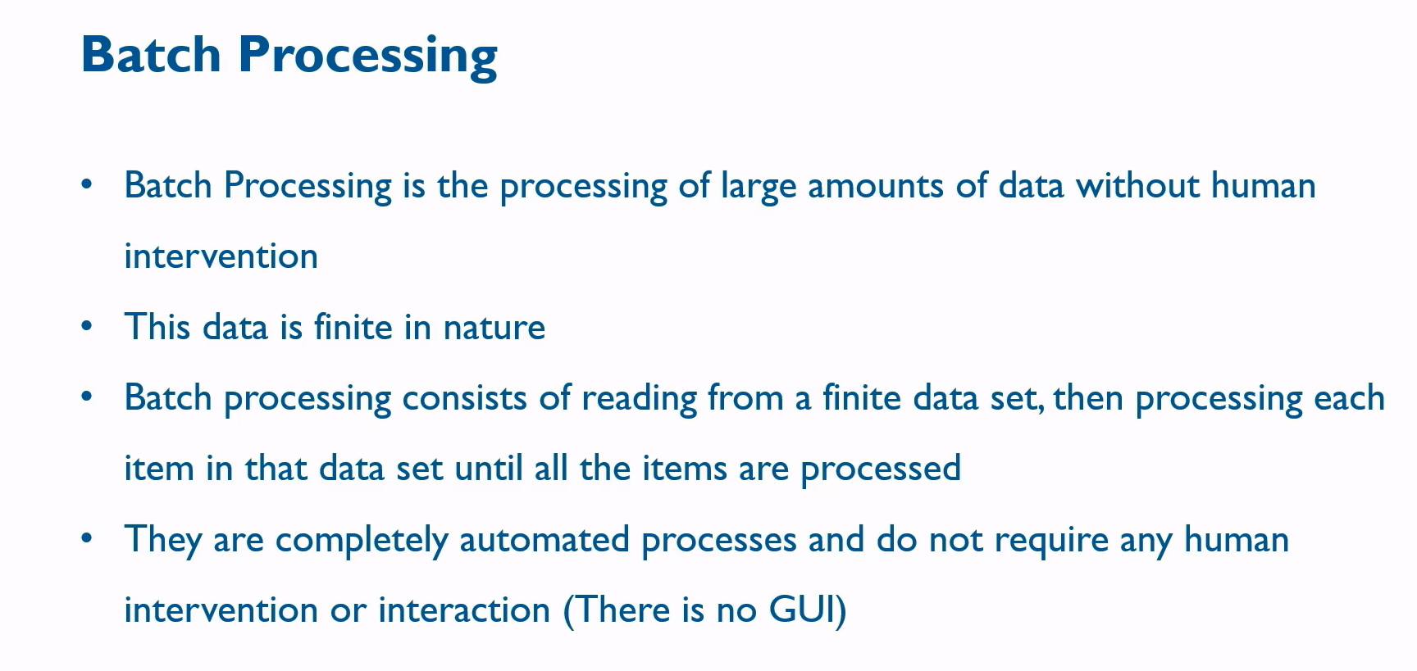
Batch Processing

Slide 3
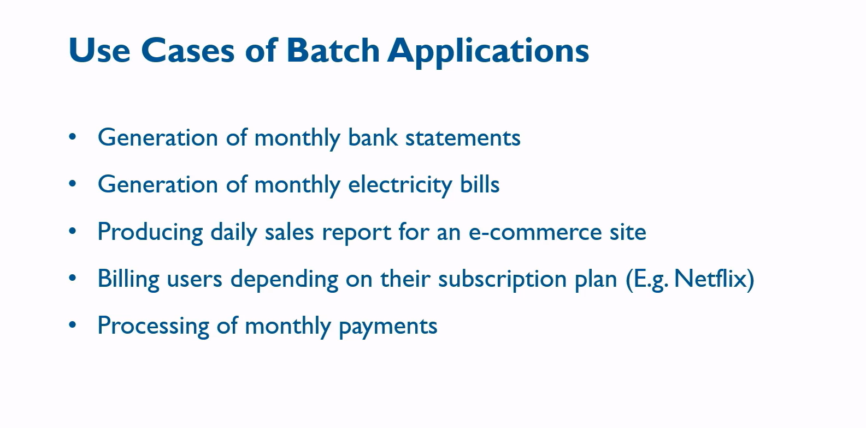
Use Cases of Batch Application

Slide 4
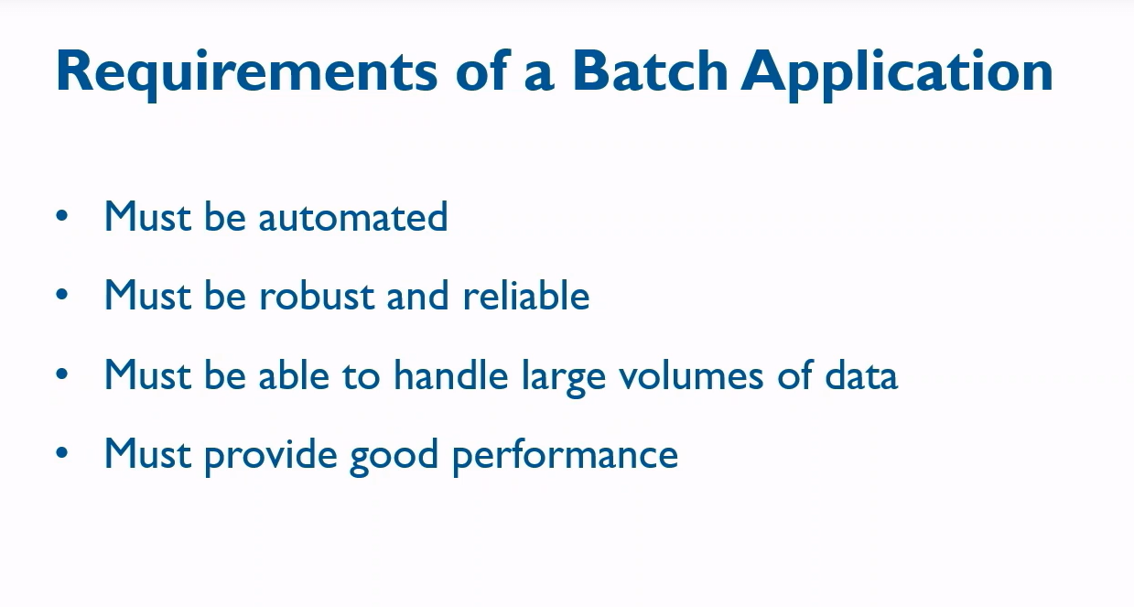
Requirements of a Batch Application

Slide 5
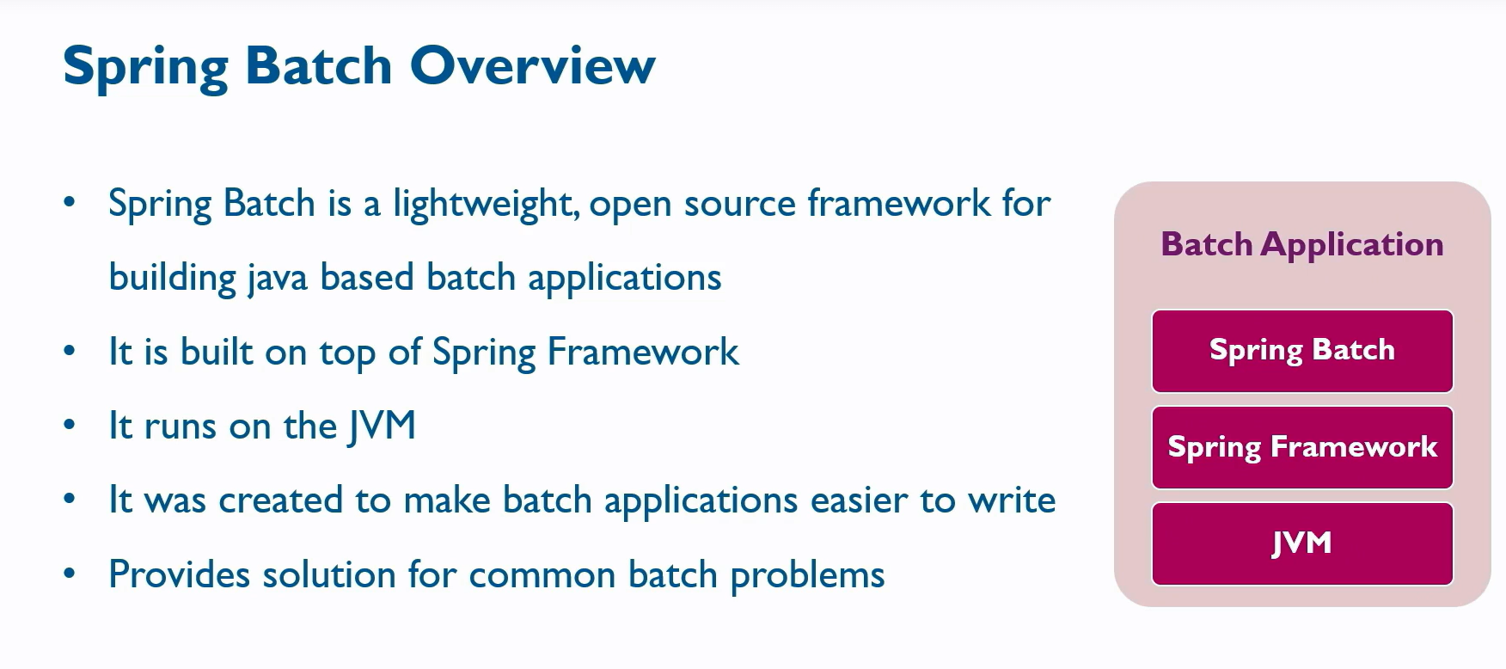
Introduction To Spring Batch

Slide 6
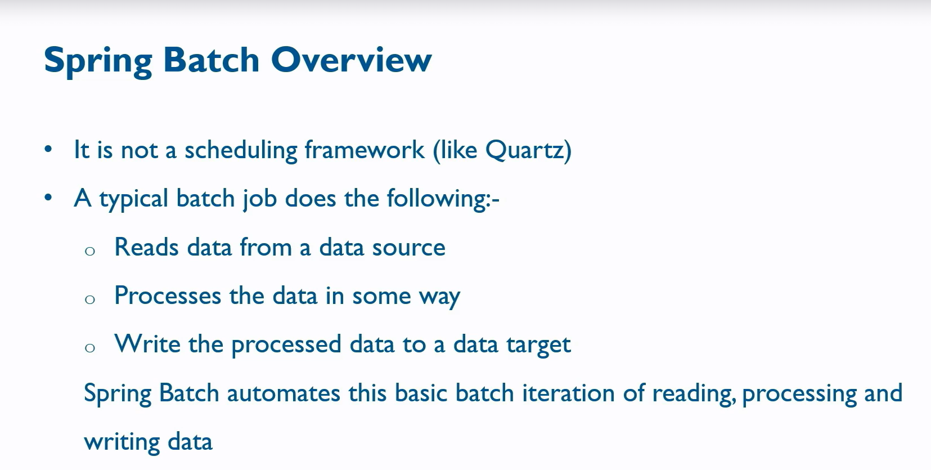

Slide 7
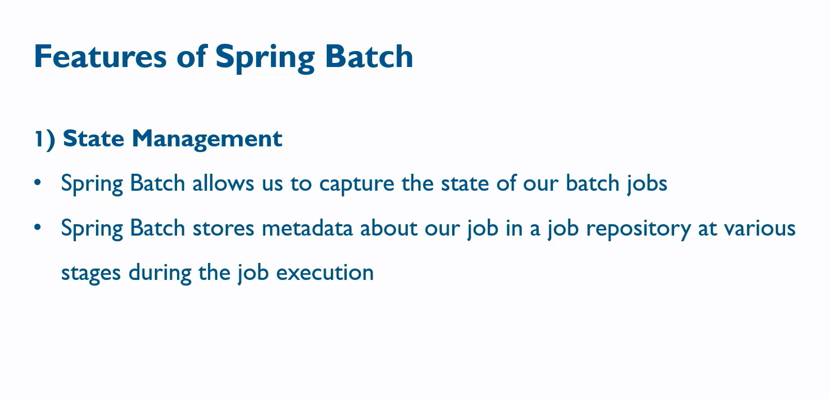
Features of Spring Batch

Slide 8
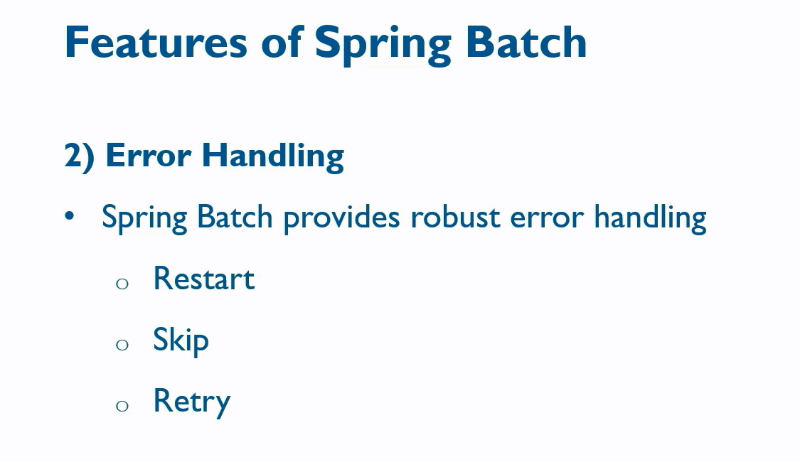

Slide 9
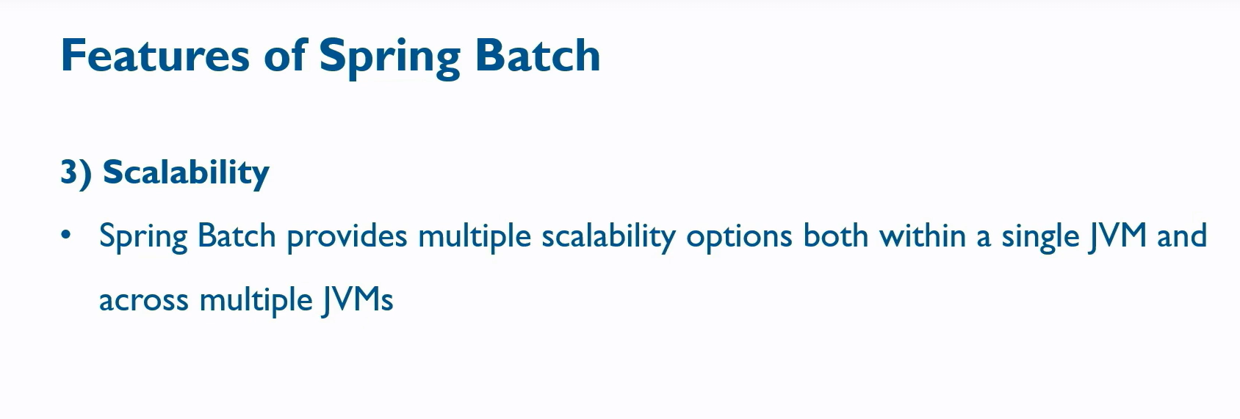

Slide 10
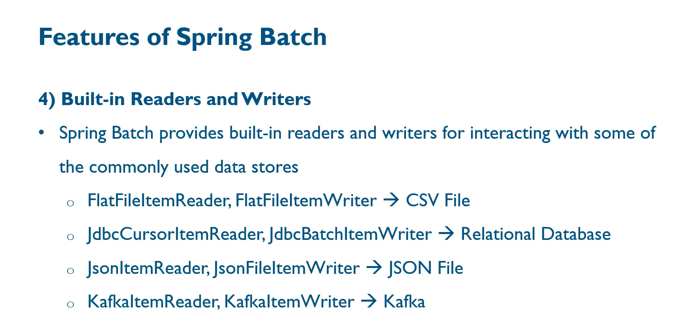

Slide 11
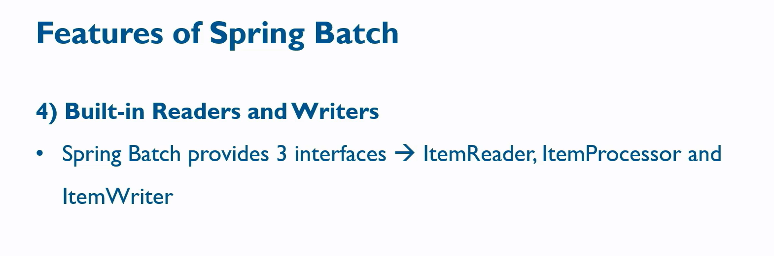

Slide 12
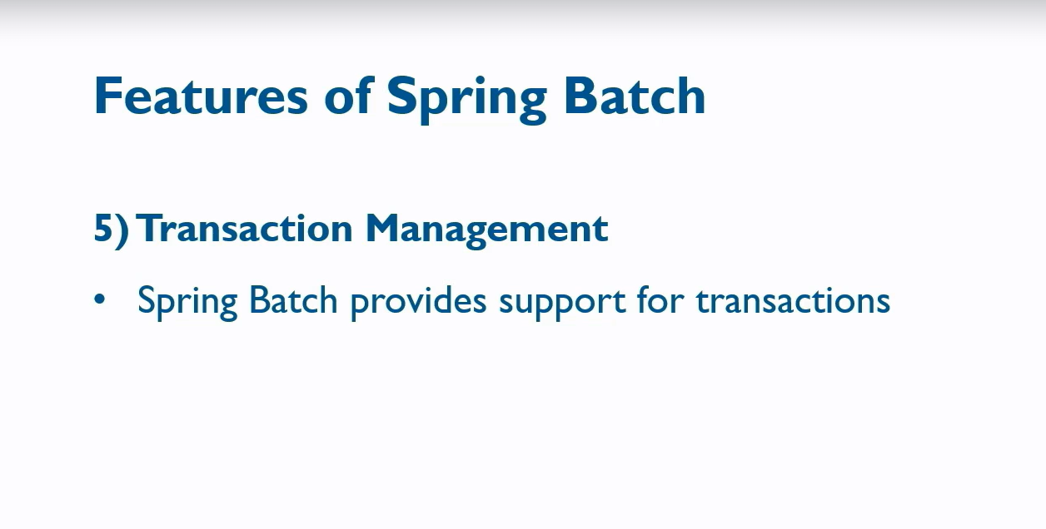

Slide 13
Basic Concepts of Spring Batch
Job
A job represents the entire flow that we are going to execute in our batch process.
It can have one or more steps that execute in an order.
Job → Step1 → step2 → step3

Slide 14
Step:
A Step is a Unit of work
It represents an independent phase in a batch job.
The steps in a job could be logically related to each other.
Generate Report Job → Collect Data →Generate Report → Send Email

Slide 15
Tasklet Step
It is used to perform Single task only.
We Need to provide the implementation for Tasklet Interface → Execute
When to use?→ a Simple DML Statement, Send an Email, Setup Resources and Clean up tasks.
Generate Report Job → Collect Data →Generate Report → Send Email

Slide 16
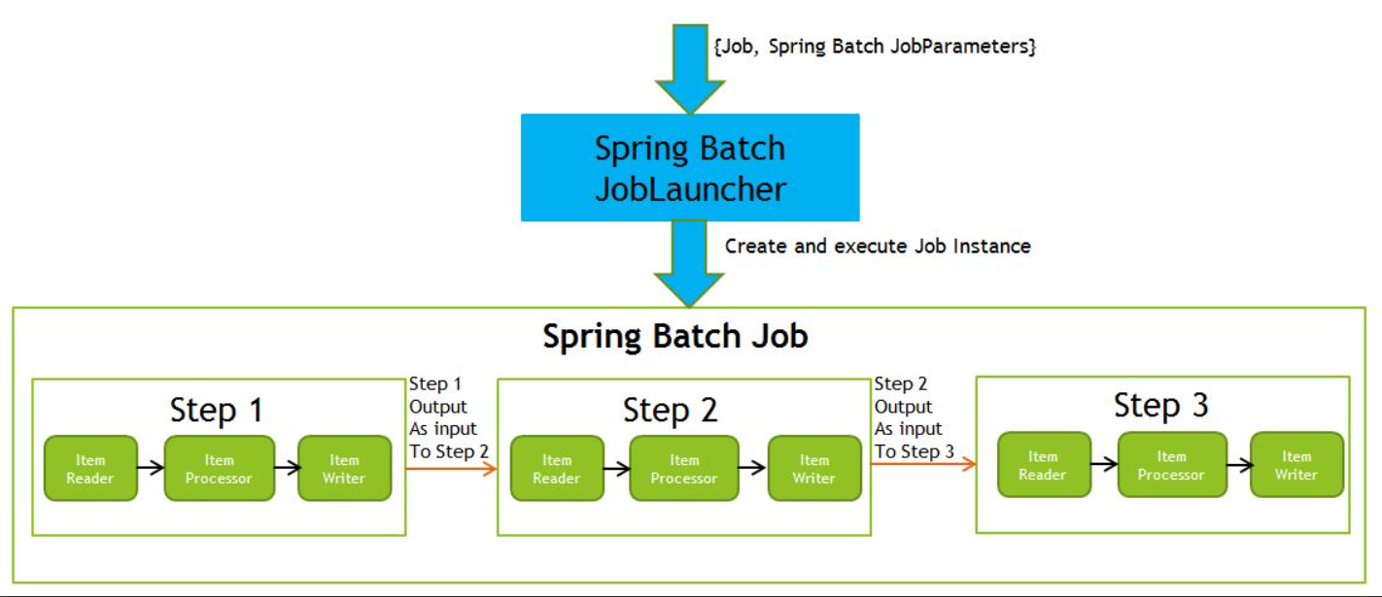
2) Chunck – based Step
It used to process data in chunks.
It has a concept of an Item → a Record which is read from or Written to a data Source.
It Contains ItemReader, ItemProcessor(optional) and ItemWriter implementation.
When to use? To Process a large file.

Slide 17
Read Product From File
Import Product Job
Import Product Step
Validate Products
Write Products To DB

Slide 18
JobLauncher
A Job Lancher is used to start the execution of a job
It Can be invoked using the scheduler, Rest API, Spring Boot.
JobRepository
It is used to store meta data about the job
It stores the job metadata in a database

Slide 19
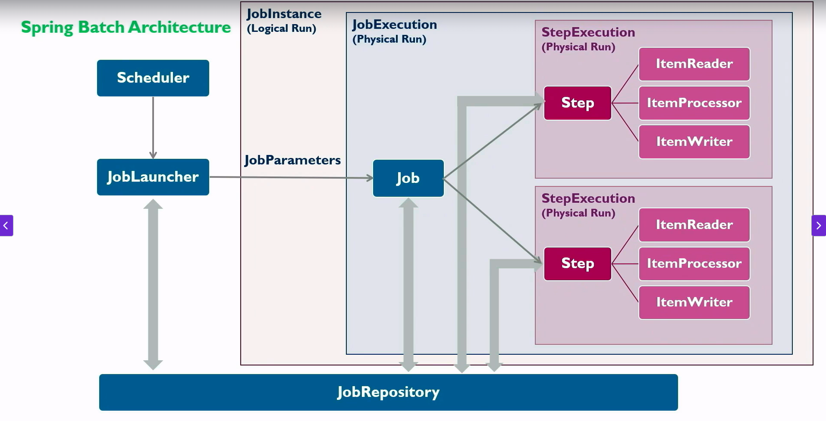
Spring Batch Architecture

Slide 20
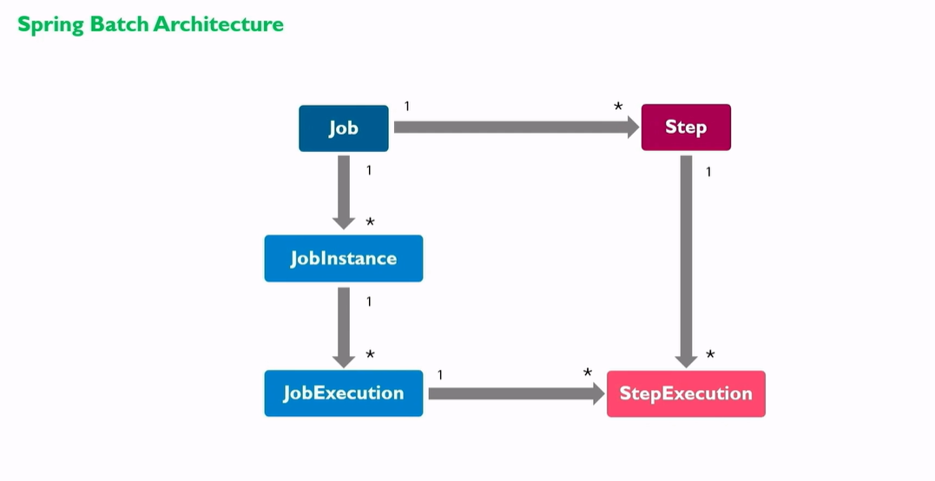

Slide 21
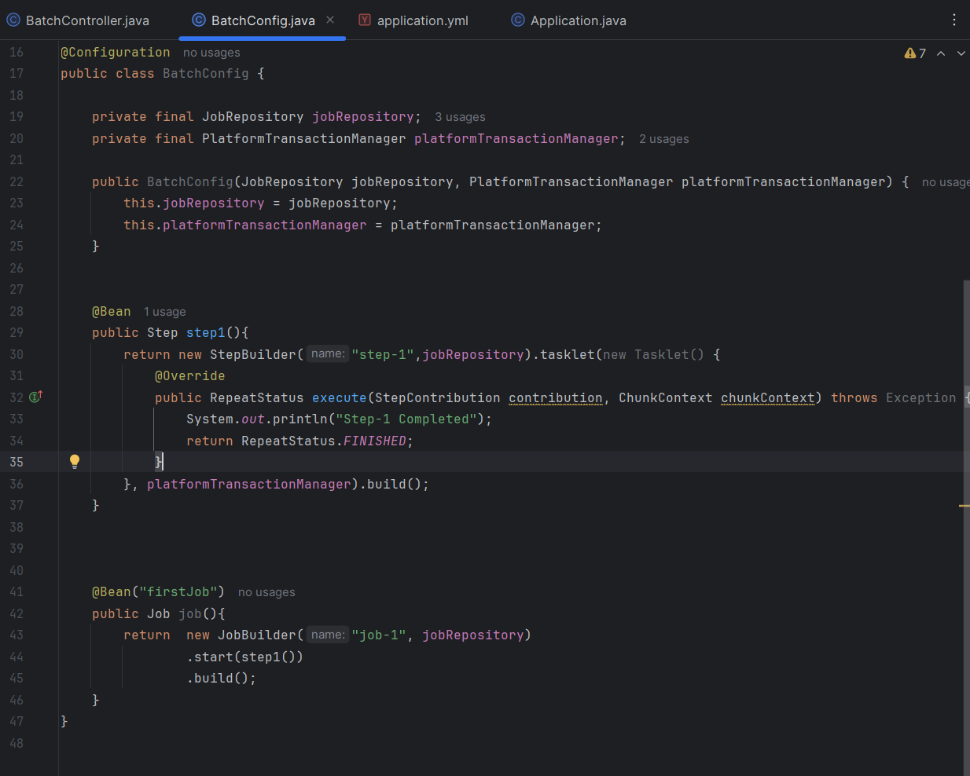
First Spring Batch Application

Slide 22
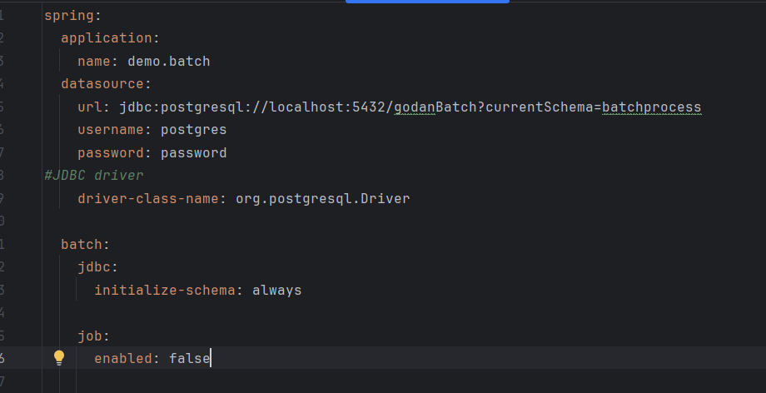
JobRepository
JobRepository is the central persistence mechanism in Spring Batch. It stores and manages the metadata for batch jobs—essentially acting as the state keeper for everything that happens during job execution.
🧠 Why It Matters
✅ Restartability: Enables jobs to resume from failure points
📊 Tracking: Records execution history for auditing and debugging
🔄 Concurrency Control: Prevents duplicate job executions
🔧 Transactional Safety: Works with PlatformTransactionManager to ensure atomic updates

Slide 23
PlatformTransactionManager
This is the core interface in Spring’s transaction infrastructure. It abstracts the underlying transaction mechanism (JDBC, JPA, JMS, etc.) and provides a consistent way to manage transactions programmatically or declaratively.
🔍 Key Responsibilities:
Begin a transaction: via getTransaction(TransactionDefinition)
Commit a transaction: via commit(TransactionStatus)
Rollback a transaction: via rollback(TransactionStatus)
🧠 Use Case:
You typically inject it into a TransactionTemplate or use it directly when you need fine-grained control over transaction boundaries—especially useful in complex batch or multi-resource operations.
Think of it as the transaction traffic controller—deciding when to start, commit, or roll back based on your logic.

Slide 24
JobBuilder
This is your entry point to define a Job, which is a container for one or more steps in Spring Batch.
🔧 What It Does:
Initializes a job with a name and JobRepository
Chains steps using .start(step).next(step)...
Supports:
Listeners
Preventing restarts
Flow control (e.g., decisions, splits)
🧠 Use Case:
Use JobBuilder when you want to orchestrate multiple steps into a cohesive batch process, with control over execution flow and restart behavior
Think of it as the director of your batch movie—deciding which scenes (steps) play in what order and how they interact.

Slide 25
StepBuilder
Part of Spring Batch’s fluent API, StepBuilder helps you construct a Step, which is the smallest unit of work in a batch job.
🔧 What It Does:
Initializes a step with a name and JobRepository
Allows configuration of:
Chunk-based processing (chunk(size, transactionManager))
Tasklets
Partitioning
Flows or nested jobs
🧠 Use Case:
Use StepBuilder when you want to define a step with custom logic, chunk size, transaction boundaries, or parallel execution strategies.
It’s like assembling a Lego block of your batch job—each step is a self-contained unit with its own behavior.

Slide 26
Running Spring Batch Job
1. importProductJob→runDate:19/9/2025 2. importProductJob→runDate:19/9/2025 [Restart Scenario]
3. importProductJob→runDate:20/9/2025
4. generateJob→runDate:20/9/2025
1
JobExecution
Scheduler
JobInstance
2
JobExecution
JobLauncher
Job
3
JobInstance
JobExecution
4
Job
JobInstance
JobExecution

Slide 27
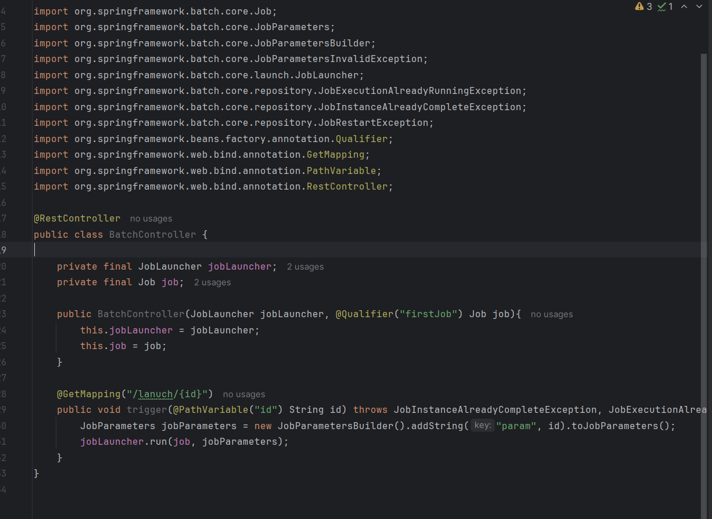
JobLauncher

Slide 28
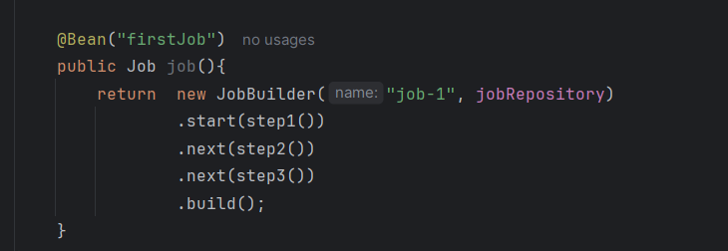
Sequential Flow : Multiple Steps in Job
We can use next() after start() for the first step in follow for the Sequential Flow.
Eg:

Slide 29
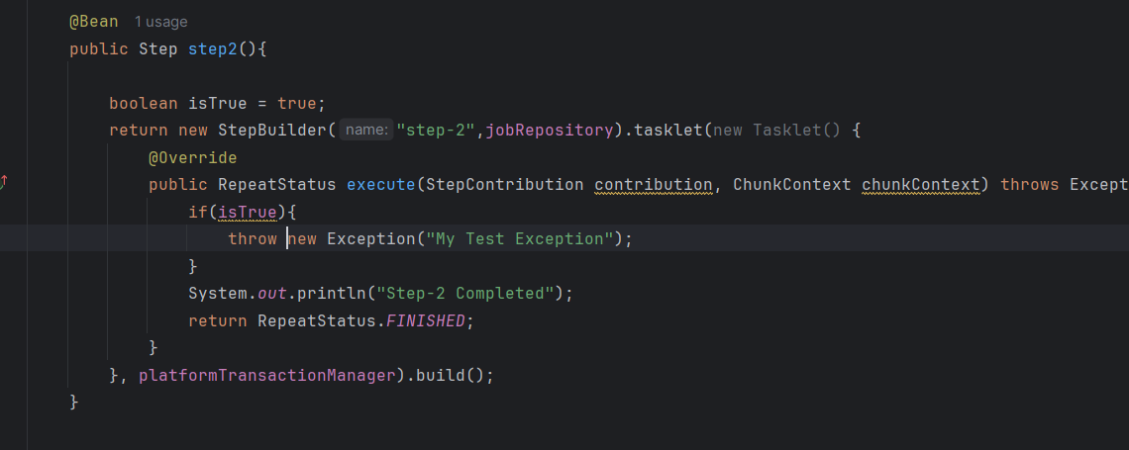
Restart Job
The Step Execution Stops in issue step and will not move forward to the next following one.
Resolving the issue and triggering the job with same parameter will do the job restart.
Code:

Slide 30
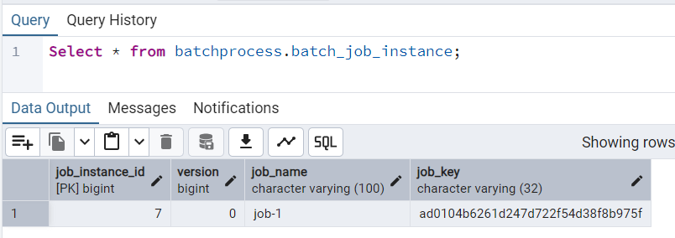
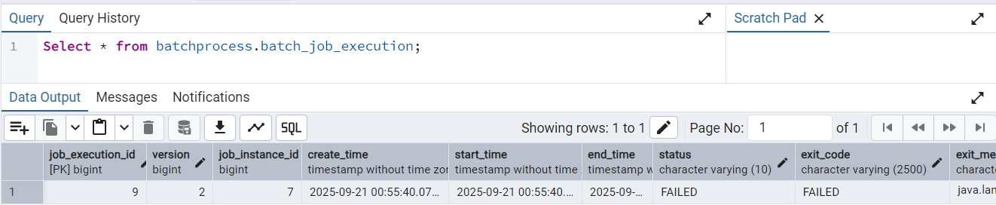
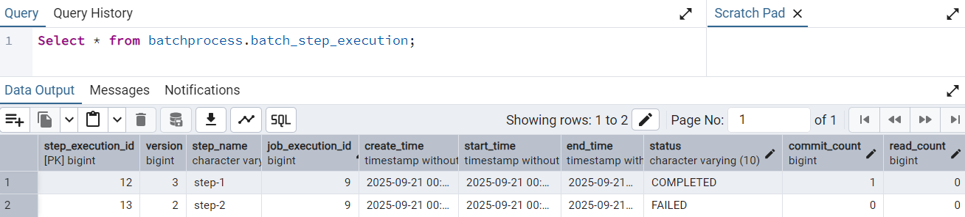
DB Details Post Run: Failure:

Slide 31
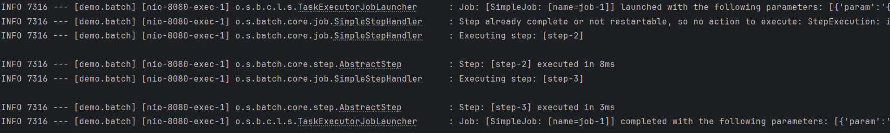
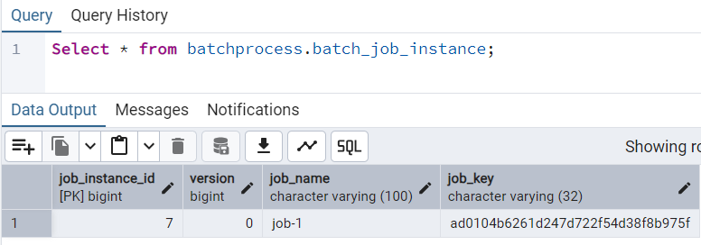
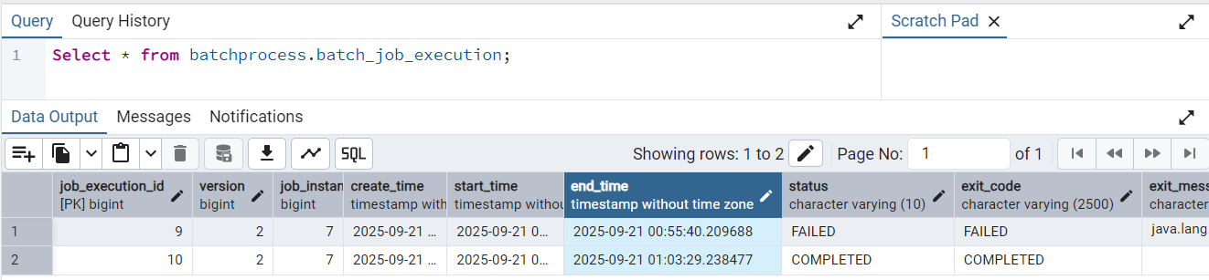
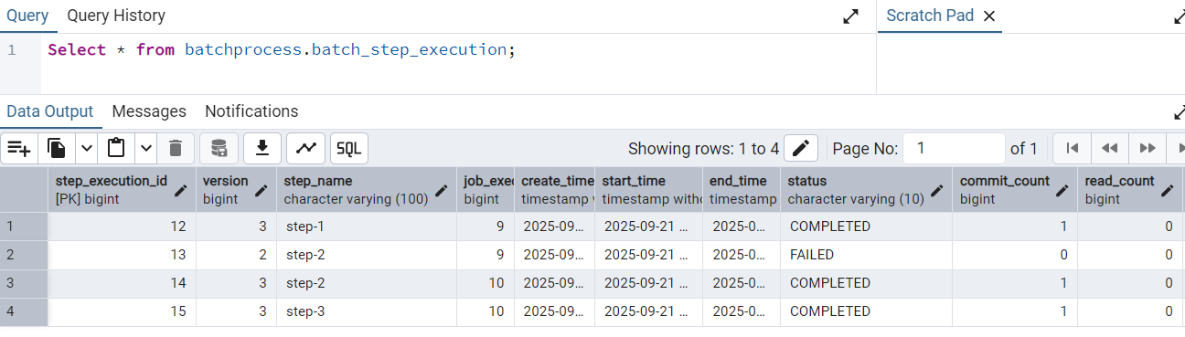
Restart Scenario

Slide 32
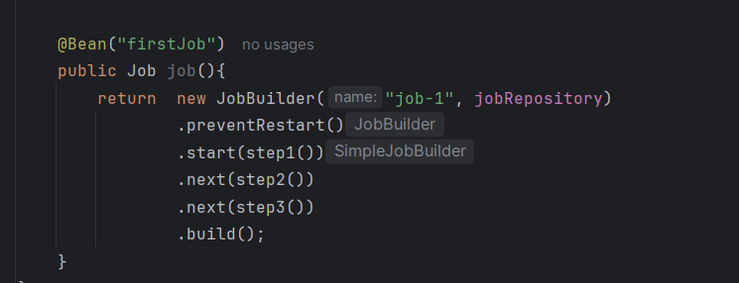
Prevent Restart:
Prevents Restart Scenario with same job param, If Job Fails in between the batch can start only with the new job param.

Slide 33
Conditional Flow - 1
step3
Yes
Success
Job
Step1
Step2
No
step4

Slide 34
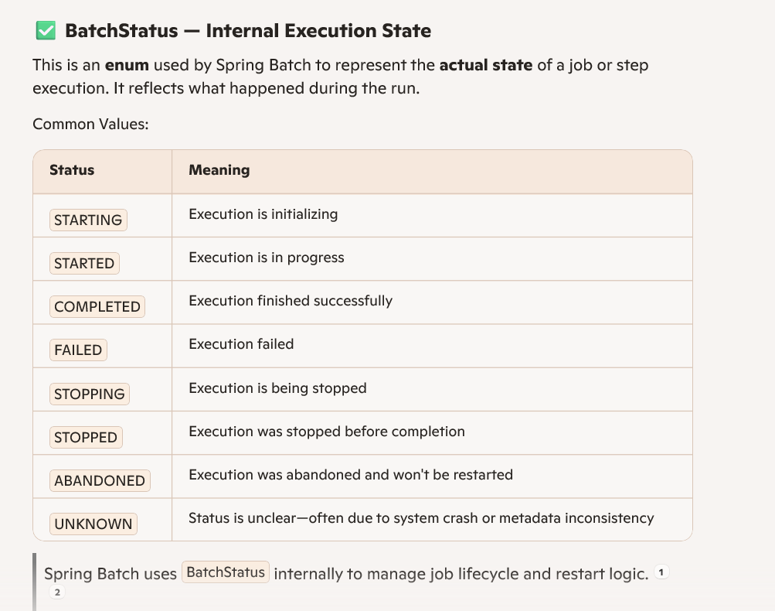

Slide 35
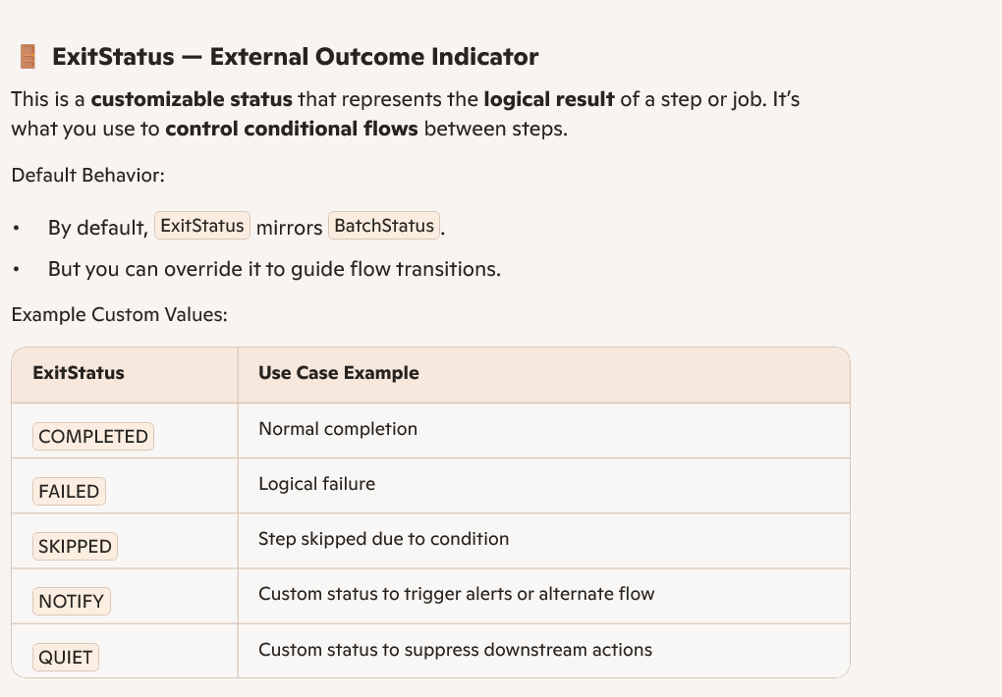

Slide 36
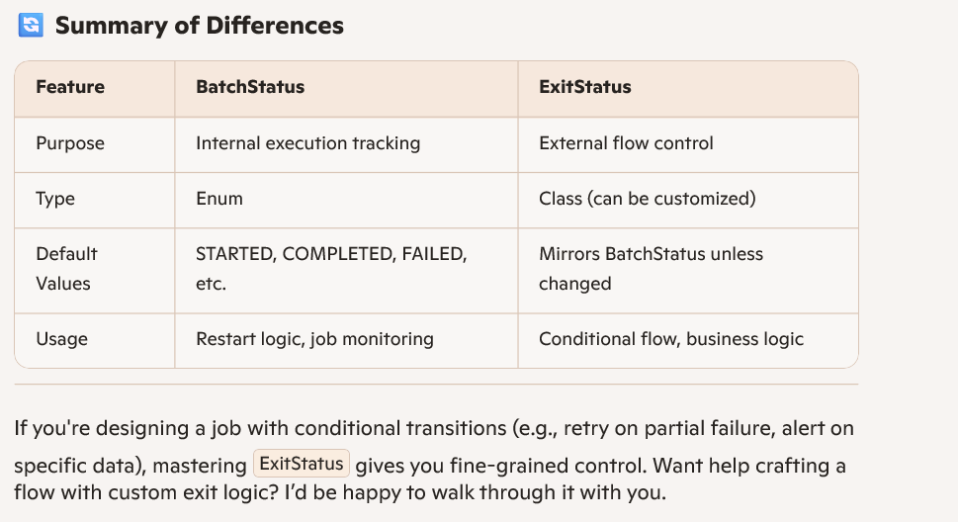

Slide 37
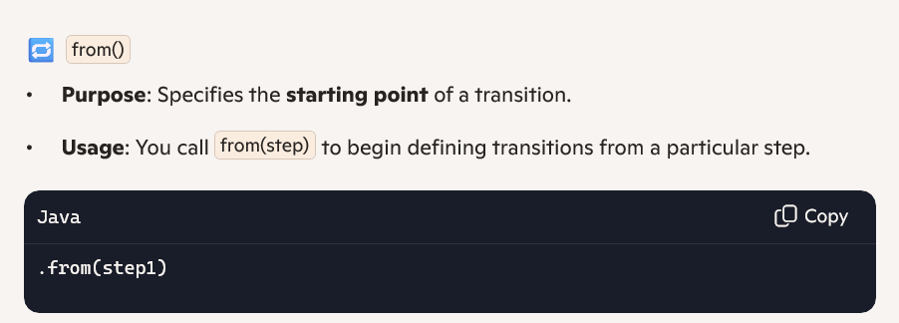
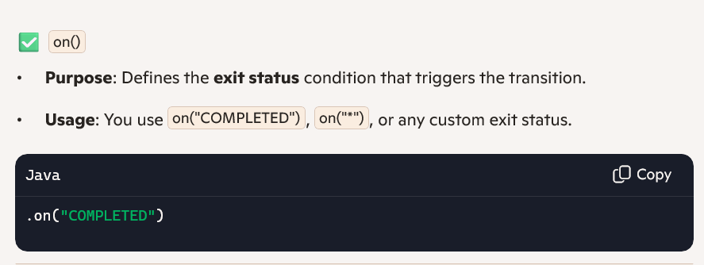
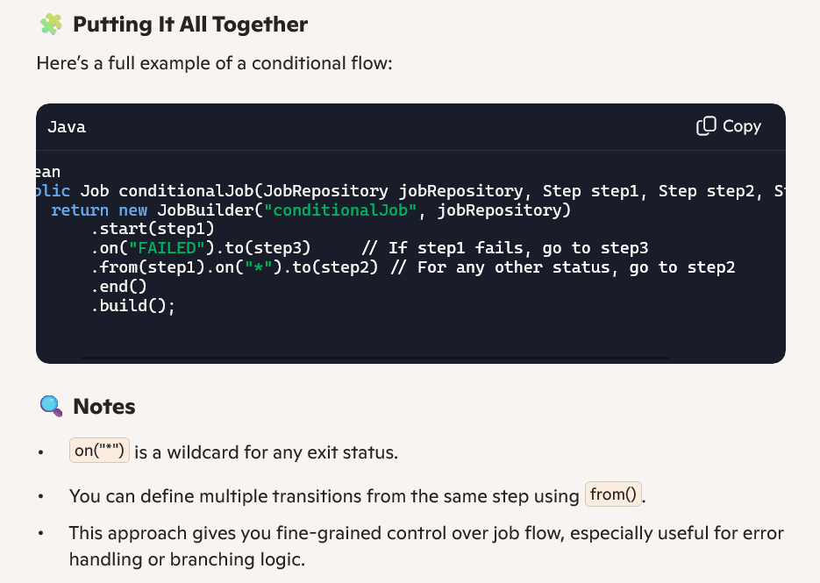
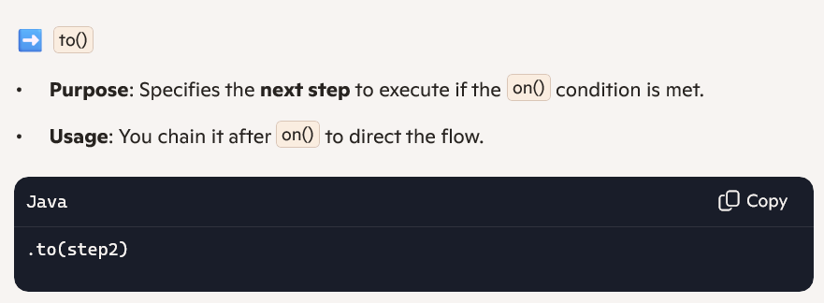
on(), to() and from():
The methods on(), to(), and from() are part of the fluent API used to define conditional step transitions in a job flow. These are especially useful when you want to control the execution path based on the outcome of a step. If you’re designing a job with multiple outcomes (like retry logic or alternate paths), this pattern is your best friend., end() should use it in the last step to stop the flow.

Slide 38
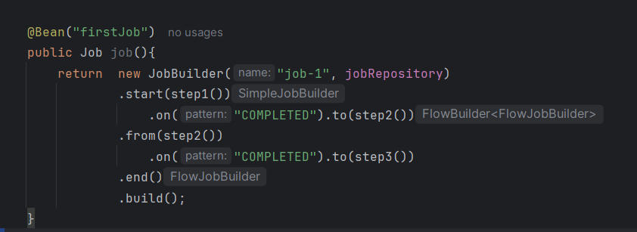
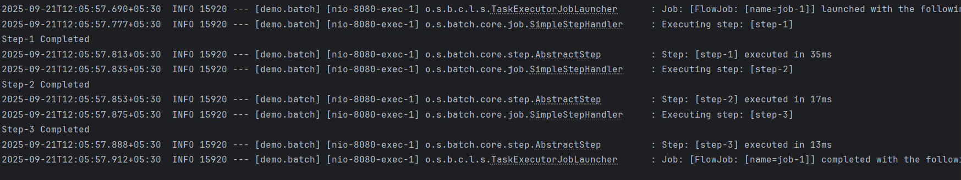
Code Example

Slide 39
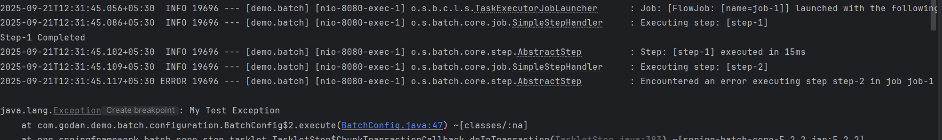
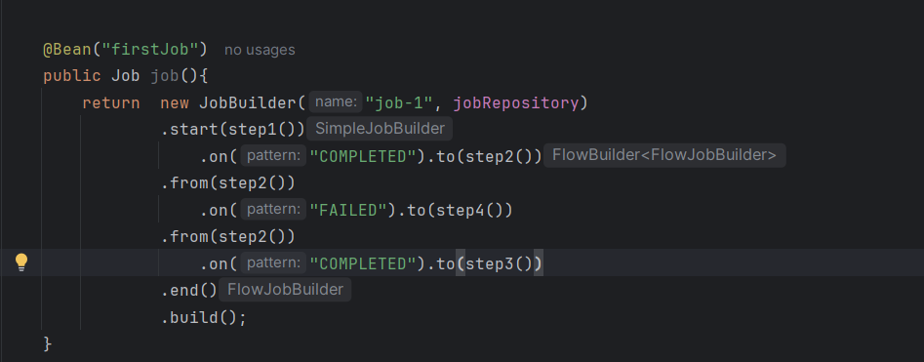
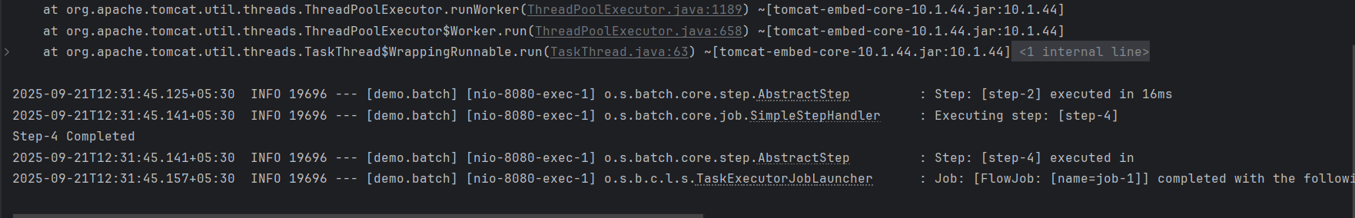
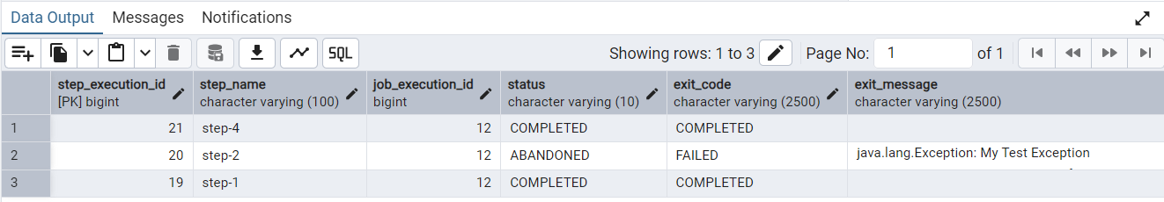
Conditional Flow - 2

Slide 40
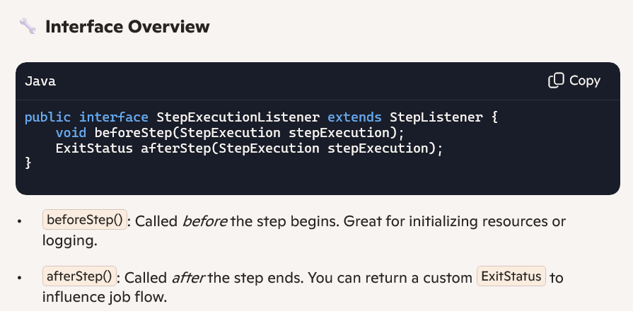
Conditional Flow - 3
StepExecutionListener:
The StepExecutionListener in Spring Batch is a powerful hook that lets you tap into the lifecycle of a Step—before it starts and after it finishes. It’s perfect for logging, resource management, conditional logic, or even injecting custom behavior based on step outcomes.

Slide 41
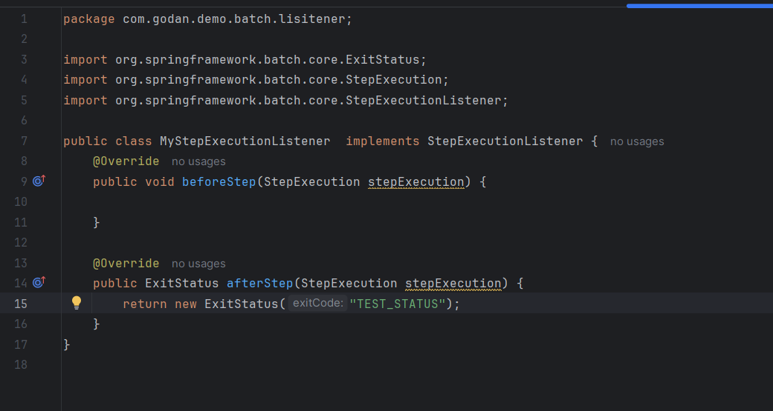
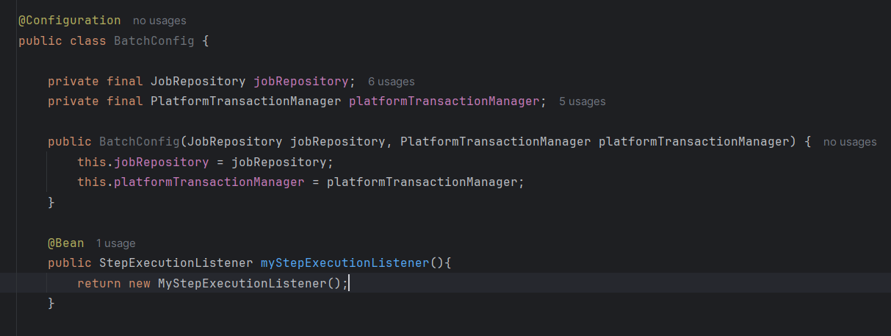
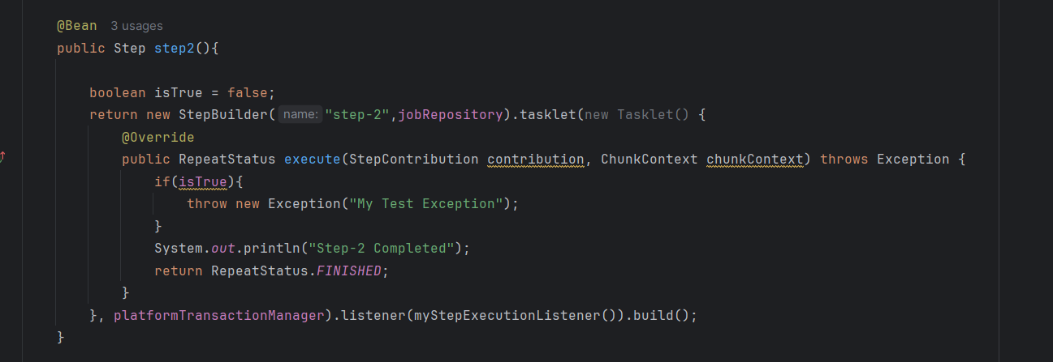
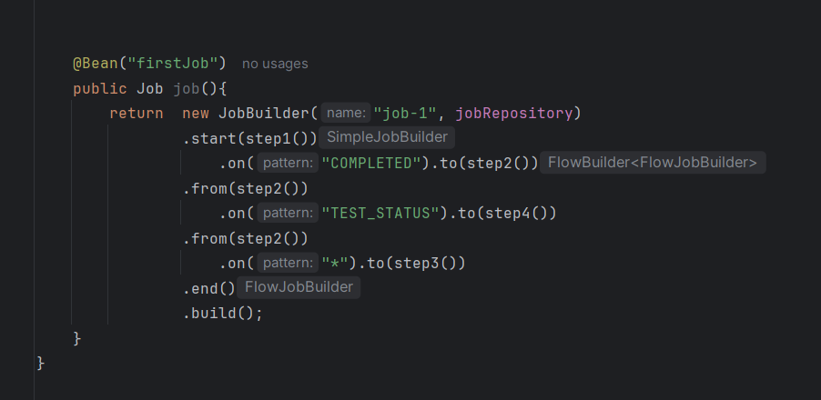
Example Implementation:

Slide 42
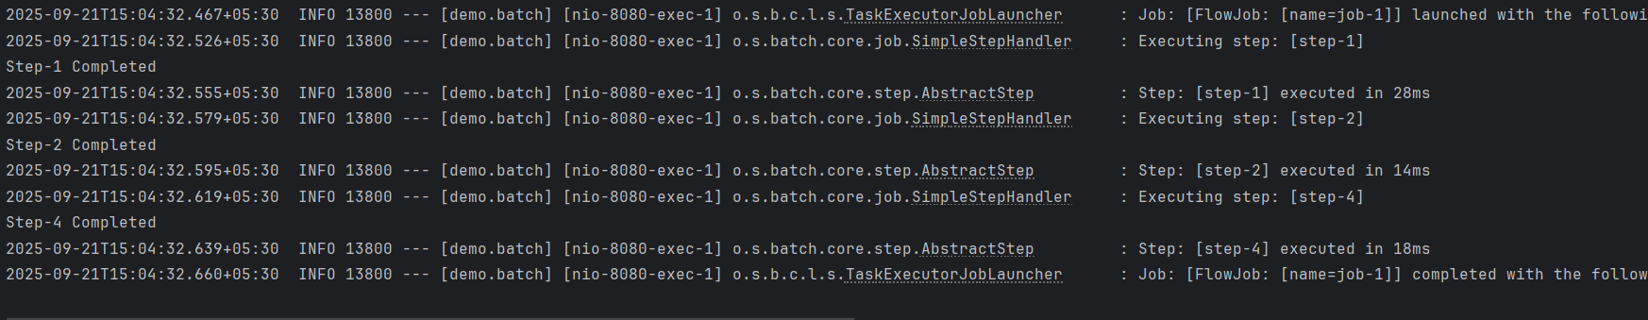
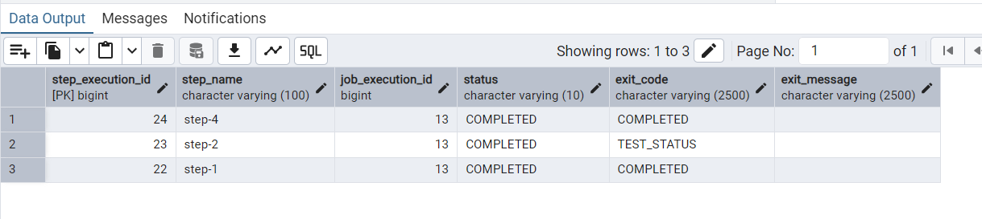
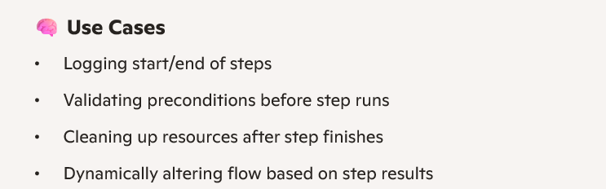
Example Implementation: Output

Slide 43
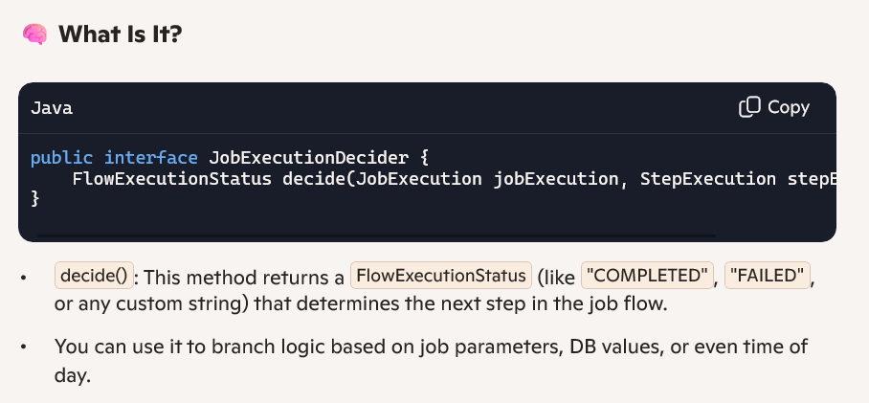
Conditional Flow - 4
JobExecutionDecider:
The JobExecutionDecider in Spring Batch is your go-to interface for programmatic control over job flow—think of it as the “if/else” logic for your batch steps. It lets you dynamically decide which step to execute next based on runtime conditions, job parameters, or even external data.

Slide 44
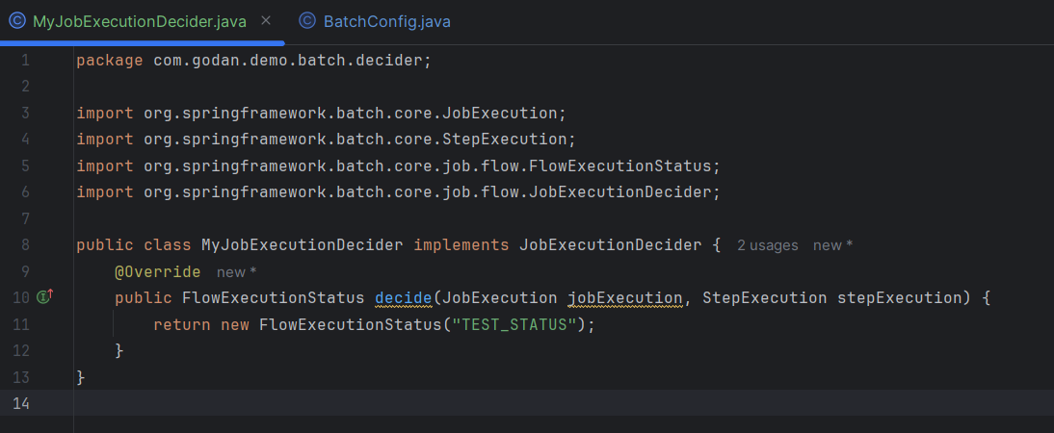


Implementation:

Slide 45


Implementation:
JobExecutionDecider Will not edit the Batch DB Meta Data exit code as StepExecutionListener.

